Slide 1
Interdisciplinary Connection
For Solving Wicked Problems

Slide 2
Agenda
01
02
03
04
What is Interdisciplinary Connection?
What are Wicked Problems?
Why does this help Fellowship Teams solve Wicked Problems?
How do we address them?
Solutioning Tool: Collective Impact Strategy
Collective Impact
Example
A leading approach to develop inclusive and socially innovative solutions. RACI Template Introduction.
Community Energy Capacity Building in Alberta

Slide 3
01
What is Interdisciplinary Connection?
How does it help us solve ‘Wicked Problems’?

Slide 4
Interdisciplinary Connections
Interdisciplinary Strategy focuses on the integration of two or more disciplines, comparing different concepts and insights across subjects to gain new knowledge.
Enables holistic, population and systems-level solutions.
Encourages value-creating behaviours (creating a larger pie), rather value-claiming behaviours (seeking the largest piece of the pie)

Slide 5
Interdisciplinary Connections
Wicked Problem Example
A province/state looks to modernize their electricity grid.
For a population or systems-level change, to this complex problem, disciplines and stakeholders which could contribute to a solution likely include:
Private Sector (Business Managers, Economists, Lawyers, Engineers)
Public Sector (Policy & Program Administrators)
Community Users (Provincial Citizens)

Slide 6
02
Wicked Problems
What are they, and how do we address them?

Slide 7
4 Types of Problems Defined
Simple
Complicated
Complex
- Most things are known.
– Agreement on problem, cause, and effective solution.
-We know the problem and what we don’t know.
-There are technical solutions (and experts to call on to create them) which are known, and therefore the problem is solvable.
- We don’t know what we don’t know.
- Don’t know the problem or solution.
-Ability to approach the problem from multiple, sometimes competing perspectives.
-Multiple solutions may be possible.

Slide 8
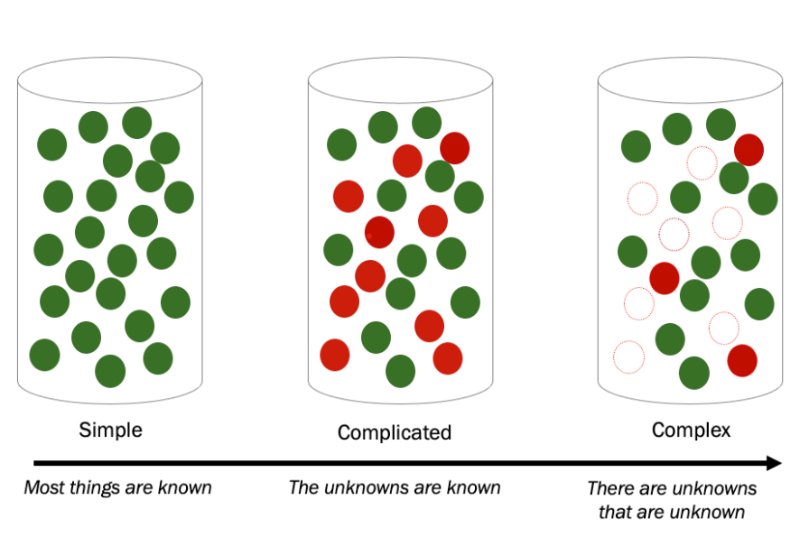
4 Types of Problems
([Simple, Complicated, Complex Problems], nd

Slide 9
Wicked Problems
Problems where there are little to no:
Agreement on the definition of the problem (owing to multiple values, perception, and perspectives)
Clear solutions to the problem owing to the wide array of possible solutions and trade-offs associated with each
Easily identified causes or authority due to the problem having multiple potential causes, jurisdictions, stakeholders and regulators or implications
The solution to problems may result in unintended consequences, that require a re-solutioning of the new problem.

Slide 10
UN SDGs and Wicked Problems
([UN Sustainable Development Goals , nd)

Slide 11
03
Collective Impact Framework
How do we use this to bring people together to achieve social change?
(Collective Impact Forum, nd)

Slide 12
Collective Impact
What is Collective Impact?
Collective impact brings together a network of community members, organizations, and institutions who advance equity by learning together, aligning, and integrating their actions to tackle complex problems, and achieve population and systems-level change.
Collective Impact social innovation approach.
(Collective Impact Forum, nd)

Slide 13
Integrated Actions for Social Change

Slide 14
Five Conditons of Collective Impact
Common Agenda
1
Coming together to collectively define the problem and create a shared vision to solve it.
2
Shared Measurement
Tracking progress in the same way, allowing for continuous learning and accountability.
Mutually Reinforcing Activities
3
Integrating the participants’ many different activities to maximize the end result. (RACI Template)
4
Continous Communication
Building trust and strengthening relationships.
Strong Backbone Organization
5
Having a team that is dedicated to aligning and coordinating the work of a group.
(Collective Impact Forum, nd)

Slide 15
Collective Impact Efforts Center Equity
Data & Context
Sytems Change
Power Shift
Grounding work to target meaningful solutions effectively
Addressing programs & services
Giving all affected and involved a voice and place at the table
Equity & Accountability
Human-Centered Solutions
Listen to and act with community
Building leadership for both into the work
(Collective Impact Forum, nd)

Slide 16
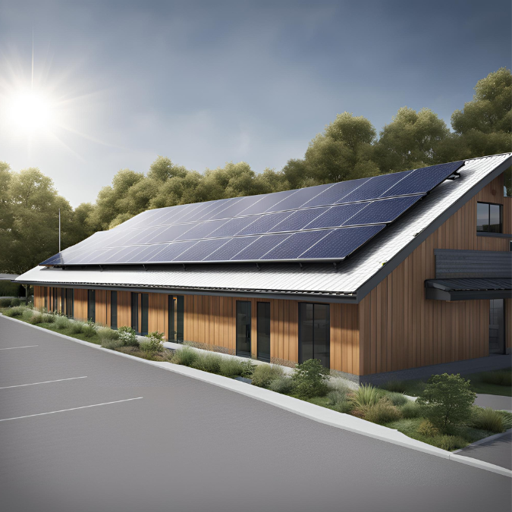
Collective Impact Example
04
Community Energy Capacity Building
Alberta, Canada

Slide 17
Community Energy Stakeholders
Private Sector
Academia
Developers, Financers, Accountants, Lawyers, Engineers, Consultants
Researchers
NGO’s
Public Sector
Advocacy Groups, Solar Associations, Cooperative Associations, Credit Unions
Policy & Program Administrators, Alberta Energy Regulator, AESO
End Users
Citizens
Small Scale Generators, Residential and Commercial Property Owners
Stakeholders
General Public,Youth

Slide 18
Example of Conflicting Problem Statements
Here is a set of conflicting problem statements that surfaced:
Modernize the Electrical Grid to make room for Small-Scale Generators
(Small-Scale Generation Solar Developers)
Enable an Economically Efficient Electricity Market ( Policy Administrators & Large Scale Developers )

Slide 19
Five Conditons of Collective Impact
Common Agenda
1
Coming together to collectively define the problem and create a shared vision to solve it.
2
Shared Measurement
Tracking progress in the same way, allowing for continuous learning and accountability.
Mutually Reinforcing Activities
3
Integrating the participants’ many different activities to maximize the end result. (RACI Template)
4
Continous Communication
Building trust and strengthening relationships.
Strong Backbone Organization
5
Having a team that is dedicated to aligning and coordinating the work of a group.
(Collective Impact Forum, nd)

Slide 20
Collective Impact Efforts Center Equity
Data & Context
Power Shift
Grounding work to target meaningful solutions effectively
Systems Change
Giving all affected and involved a voice and place at the table
Addressing programs & services
Equity & Accountability
Human-Centered Solutions
Listen to and act with community
Building leadership for both into the work
(Collective Impact Forum, nd)

Slide 21
Solution – Shared Vision
Leaders from Cooperatives, Credit Unions, Solar Developers, Solar Engineers, Solar Associations, Electricity Marketing Professionals and our Government Administration (Deputy Minister of Energy) were brought together to dialogue. Co-create policy suggestions with lawyers, and lobby for specific Small Scale Generation Policy.
Small Scale Generators policy was written collaboratively with the government policy writers, and supportive Programming was put into place.

Slide 22
Questions?

Slide 23
References
Scrum.org (nd) Simple, Complicated, Complex Problems. Retrieved June 17, 2024 from https://www.scrum.org/resources/what-are-some-differences-among-simple-complicated-and-complex-problems-and-work#:~:text=Complex%20problems%20are%20those%20where,has%20an%20impact%20on%20others
[Image of Simple, Complicated, Complex Problems]. (nd). Retrieved June 18, 2024, from https://www.scrum.org/resources/what-are-some-differences-among-simple-complicated-and-complex-problems-and-work#:~:text=Complex%20problems%20are%20those%20where,has%20an%20impact%20on%20others
[Image of UN Sustainable Development Global Goals]. (nd). Retrieved June 18, 2024, from https://www.un.org/sustainabledevelopment/news/communications-material/
Collective Impact Forum (nd) What is Collective Impact? Retrieved June 17, 2024 from https://collectiveimpactforum.org/what-is-collective-impact/

Slide 24
Thanks!
Do you have any questions?
Reva George
Reva.George@norquest.ca
Please keep this slide for attribution

